Slide 1
Getting started with Graph API and PowerShell
Alexander Holmeset
Cloud Consultant / CloudWay
@AlexHolmeset

Slide 2
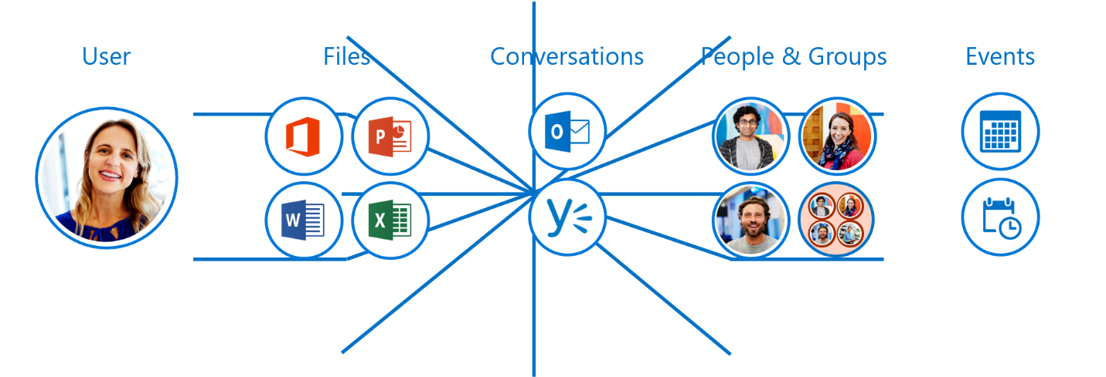
History of Graph API
Office Graph
Working in silos
Like a huge spidersweb

Slide 3
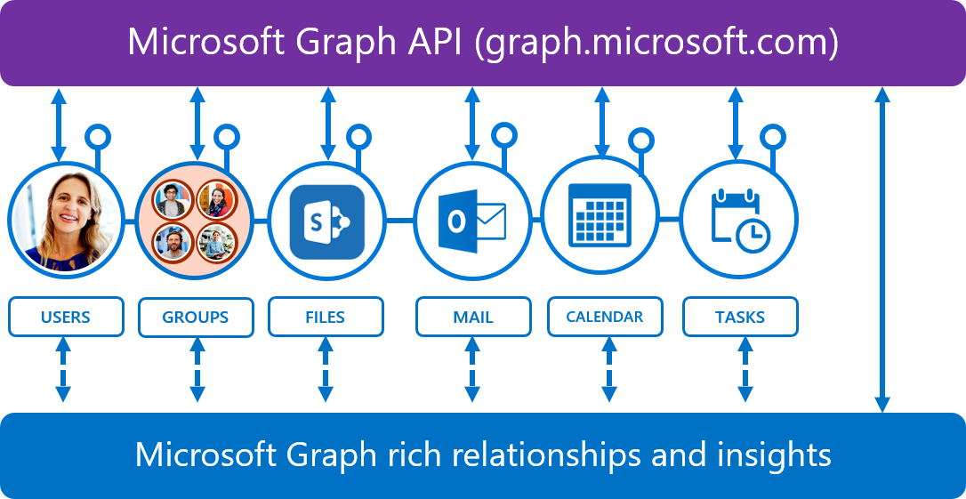
History of Graph API

Slide 4
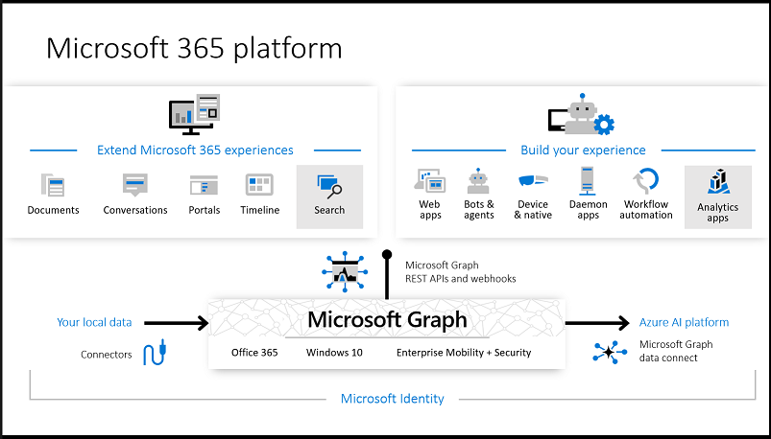

Slide 5
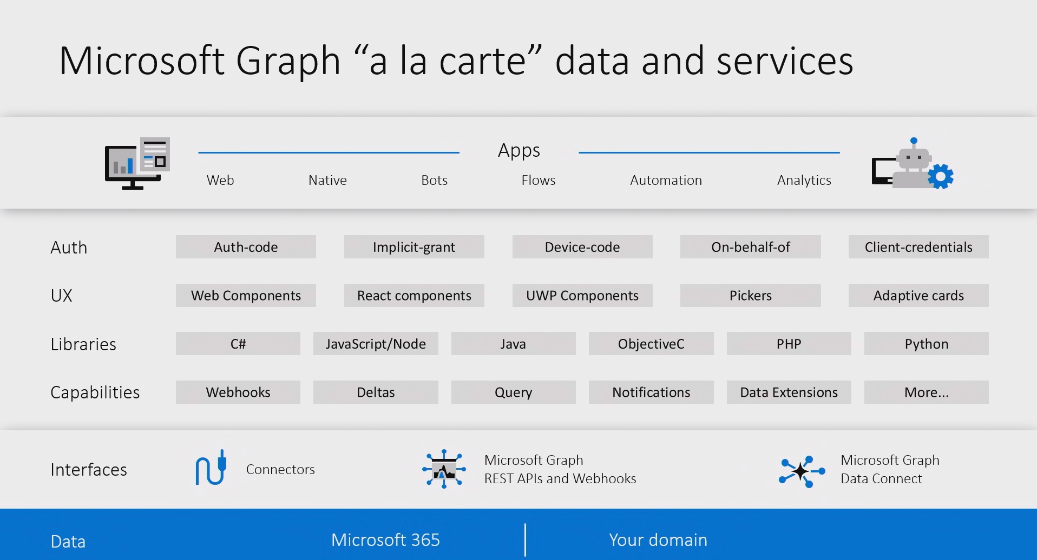

Slide 6
How to communicate?
https://graph.microsoft.com/
V1.0 or beta
HTTP Methods
Azure AD token

Slide 7
Demo Graph Explorer

Slide 8






Slide 9


Slide 10


Slide 11


Slide 12
Demo WebRequest/RestMethod

Slide 13
Demo JSON Formating

Slide 14
Azure Application
Microsoft Identity
id_token
access_token
refresh_token
YOUR APP
MSAL or ADAL
access_token
Microsoft Graph

Slide 15





App types and permissions
Get access on behalf of users
Get access as a service
Single page app
Web app
Mobile or desktop app
App with
middle tier web API
Service or
daemon app
Permission type: delegated
Permission type: application
Effective permission
Effective permission
Delegated permissions
User privileges
App permissions
Users can consent for their data or admin can consent for all users
Only admin can consent
Learn more: https://aka.ms/ConsentAndPermissions

Slide 16
Permissions
Microsoft Graph permission names:
Resource . Action . Scope
_{Examples}
_{User.Read}
_{Notes.ReadWrite}
_{Directory.ReadWrite.All}
target entity
files, mail, groups, calendars, etc…
Read,
ReadWrite, etc.
specific: .All, .Shared, etc
inferred

Slide 17
Demo Azure Application

Slide 18
Demo Usecases

Slide 19
